Slide 1
Euler Circuit
Bao Chau
Bruce Decker
So Choi
Vignesh Senthil

Slide 2
An Euler circuit is a circuit that uses every edge of a graph exactly once.

Slide 3
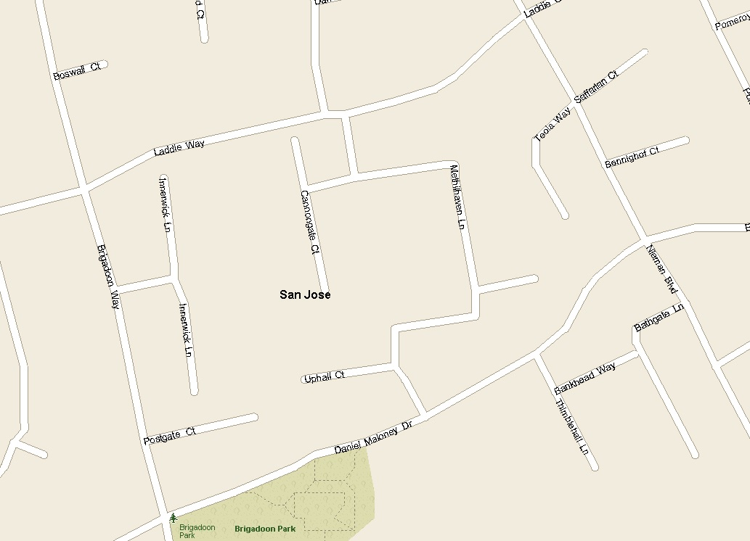
Mailman Problem

Slide 4
Must deliver mail to every home
To do this efficiently, must visit every street only once
There may be a shortcut between roads (Add edge)
Road may be closed (Delete edge)

Slide 5
Vertex

Slide 6

Edge
Vertex

Slide 7
